Slide 1
Lecture 1 Introduction to Statistical Methods

Slide 2
Answering Questions with data
What proportion of people in the U.S are biologically female?
Survey Americans and ask them to report their sex
Does a low-carb diet result in significant weight loss?
- Design an experiment to evaluate the effectiveness of the low carb diet on weight loss
- Record information such as starting and ending weight, calories consumed per day, …
Are people more likely to stop at Starbucks if they’ve recently seen a Starbucks TV add?
Conduct a marketing survey to record the number of people who have gone to starbucks since add aired
Compare between those who saw the add and those who did not

Slide 3

Where do we find Statistics? – Everywhere!
Sports (number of points scored per game by an athlete)
Weather Forecasting (average monthly rainfall)
Economy (median income, unemployment rate)
Sales Tracking (projected sales revenue from iphone 14’s sold in a given month)
Medicine (percentage of people who were pain free from using a drug)
Manufacturing (number of cans of coke produced in a given month)
The science of statistics deals with the collection, analysis, interpretation, and presentation of data
Data is a collection of observations/measurements

Slide 4
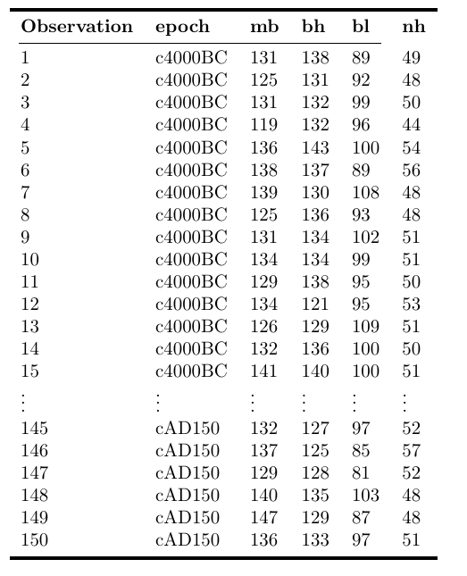
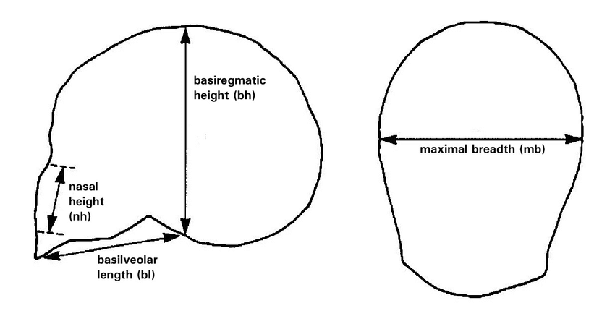
What Do Data Look Like?
The following are data from an analysis of 150 Egyptian skulls from 5 epochs of Egyptian history. For each skull, the epoch, and several measurements characterizing the shape of the skull are recorded
Source: D. J. Hand, F. Daly, A. D. Lunn, K. J. McConway and E. Ostrowski (1994). A Handbook of Small Datasets, Chapman and Hall/CRC, London.
Visualizing Tests for Equality of Covariance Matrices - Scientific Figure on ResearchGate. Available from: https://www.researchgate.net/figure/Diagram-of-the-skull-measurements-for-the-Egyptian-skulls-data-set-Maximal-breadth-and_fig4_325126938 [accessed 21 Aug, 2023]

Slide 5
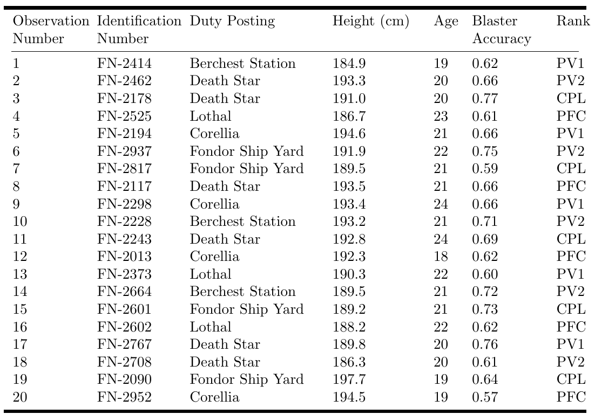

Example Data 2
The following table contains fictional data consisting of 20 observations of storm troopers who have just graduated from the Empire’s Imperial Academy. The height, age, blaster accuracy, and future duty posting are recorded for each storm trooper
This Photo by Unknown Author is licensed under CC BY-NC-ND

Slide 6
Checkpoint:
Data - a collection of observations/measurements on a set of variables - typically represented as a table.
Observation – the fundamental unit of data – typically observations are rows of a data table
Variables – characteristics of an observation – typically variables are the columns of a data table

Slide 7
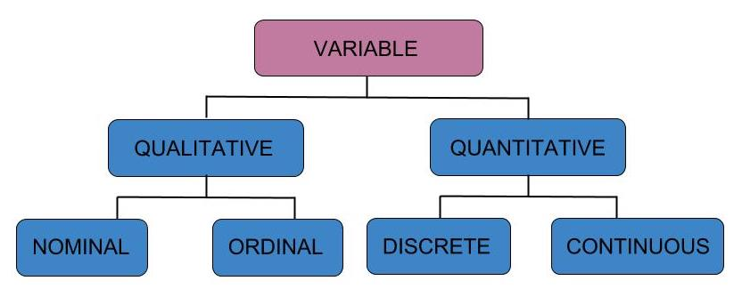
Types of Variables: Qualitative vs Quantitative

Slide 8

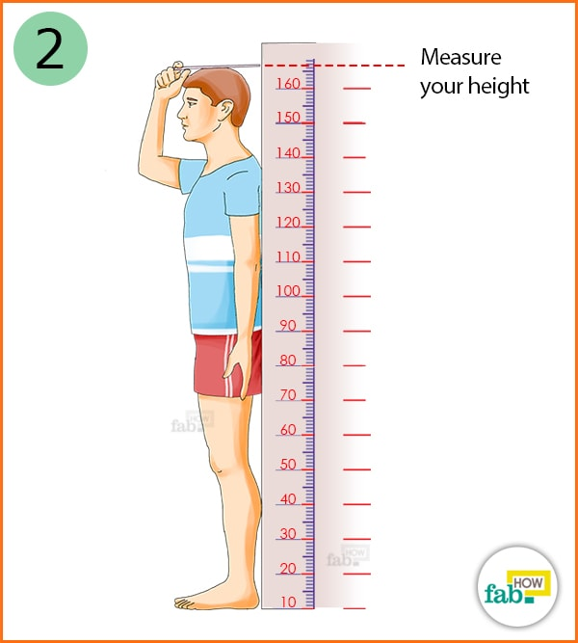
Types of Variables: Qualitative vs Quantitative
Qualitative (Categorical) variable – non-numeric qualities or characteristics that can be placed in distinct categories
State/city (ID, WA, MT, ...)
Treatment (Drug/Placebo)
Genotype (AA, AT, TT)
Survival (live or die)
Quantitative (numeric) variable – numerical characteristics - can be ordered or ranked
Height (inches/cm)
Weight (lbs/kg)
Longevity/Age (number of years)
Dose (micrograms per gram)

Slide 9

Practice: Qualitative vs Quantitative
From our example data of egyptian skulls, which variables are qualitative and which are quantitative?
Qualitative: Epoch
Quantitative: mb, bh, bl, nh

Slide 10
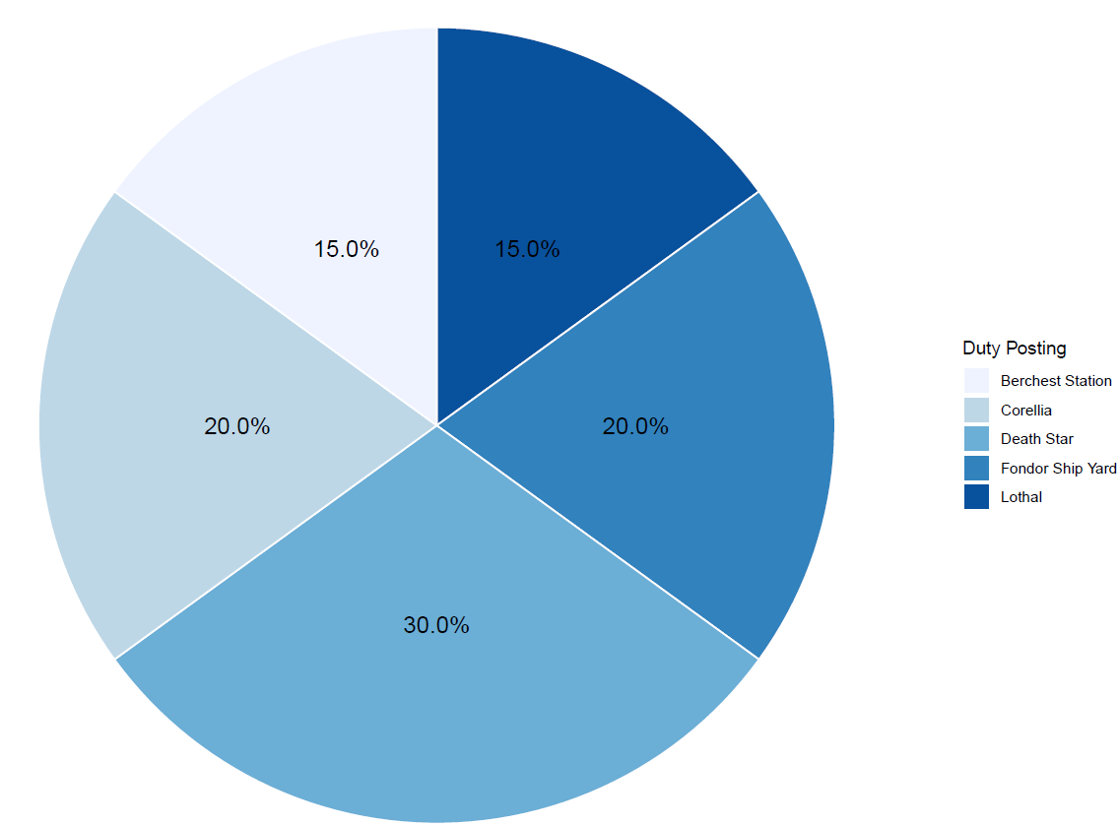
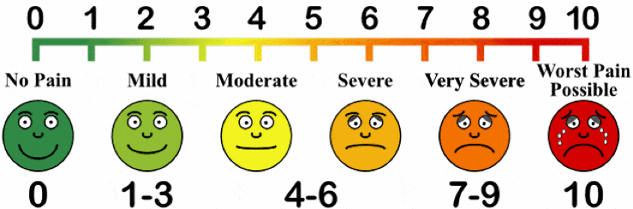
Types of Variables: Qualitative vs Quantitative
Qualitative nominal – non-numeric qualities or characteristics that can be placed in distinct categories that do not have a natural ordering (e.g labels, names, colors, etc)
Qualitative ordinal – non-numeric qualities or characteristics that can be placed in distinct categories with an inherent ordering (Likert responses, education level, military ranking)
This Photo by Unknown Author is licensed under CC BY-NC-ND

Slide 11
Practice: Qualitative vs Quantitative
In the stormtrooper example data, which variable(s) are qualitative nominal and which are qualitative ordinal?
Qualitative nominal: ID Number, Duty Posting
Qualitative ordinal: Rank

Slide 12
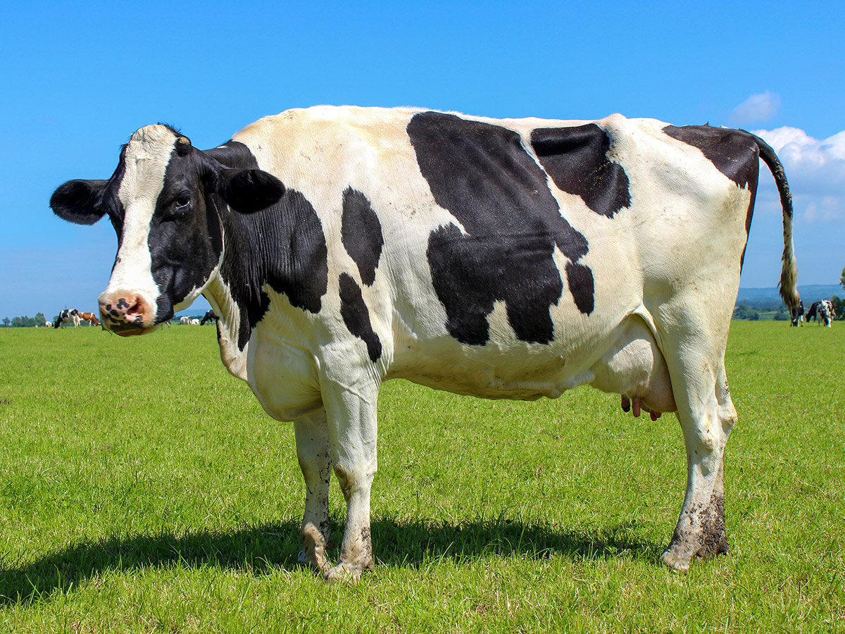


Quantitative Variables: Discrete vs Continuous
Quantitative discrete – quantitative variables that take on distinct, countable values such 0,1,2,3… (whole numbers or integers)
- all counts are quantitative discrete variables
Quantitative continuous – variables that can take on infinite number of values within an interval of any two specific values (e.g temperature ◦F, height in inches, speed in miles per hour)
e.g. number of black
spots on a dairy cow
Min
Max
Moscow, ID Daily Surface Temperature
(July)
$$40℉$$
$$97℉$$

Slide 13
Practice: Discrete vs Continuous
In the stormtrooper example data, which variable(s) are quantitative discrete and which are quantitative continous?
Quantitative discrete: Age (a count of the number of years)
Quantitative continuous: Height, Blaster Accuracy

Slide 14
Sampling and Data
Statistics is generally concerned with studying properties of a population – the collection of all possible persons, events, or objects of interest
e.g the set of all possible observations – observed + unobserved
Populations can be real and finite/countable (e.g. All employees at a company) or hypothetical and potentially infinite/uncountable (e.g all possible hands in a game of poker)
A Sample is a subset of the population that we actually observe – the observed observations
The idea of Sampling is to select a portion or individuals or objects that are representative of the population
By studying the sample we can gain insights about the population
Population
Sample

Slide 15
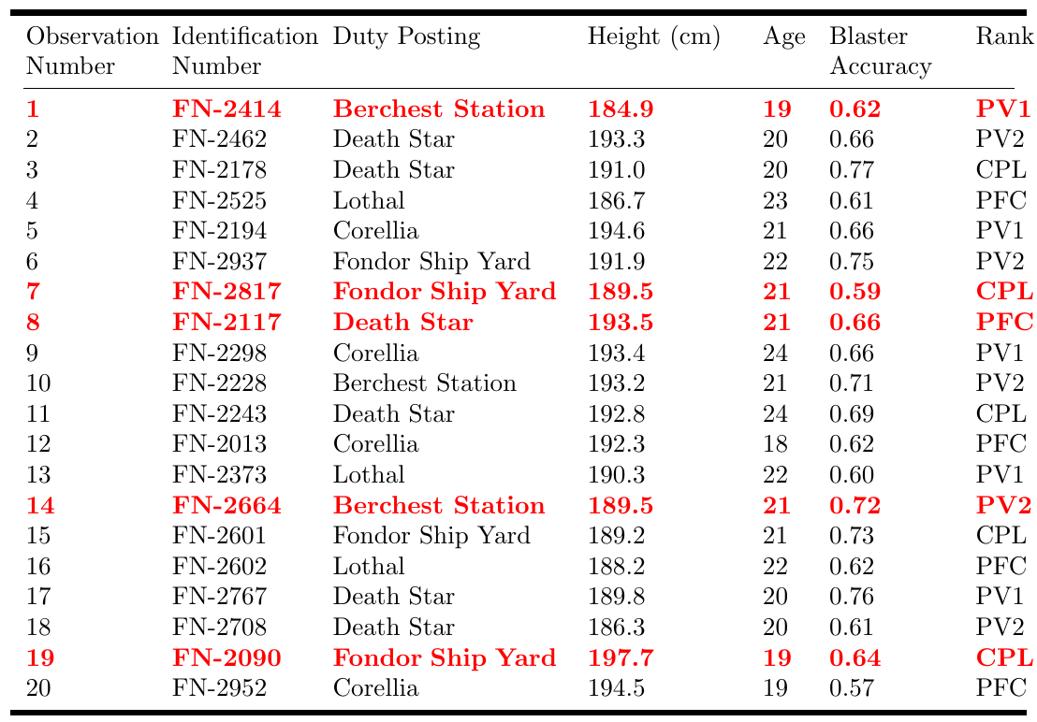
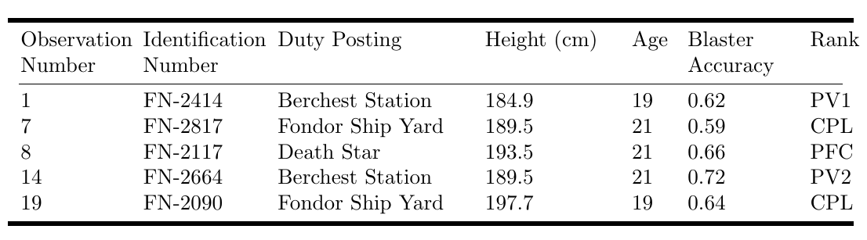
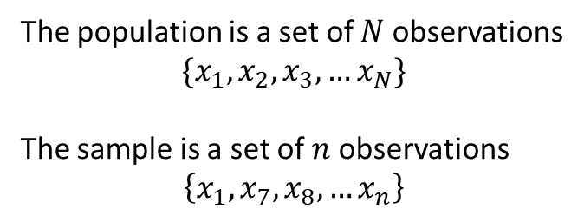
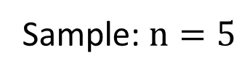
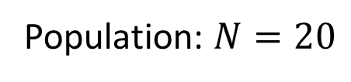
Example
The population is a set of $N$ observations
$$\{x_{1}, x_{2},x_{3},…x_{N}\}$$
The sample is a set of $n$ observations
$$\left\{x_{1},x_{7},x_{8},…x_{n}\right\}$$
Population: $N=20$
Sample: $n=5$

Slide 16
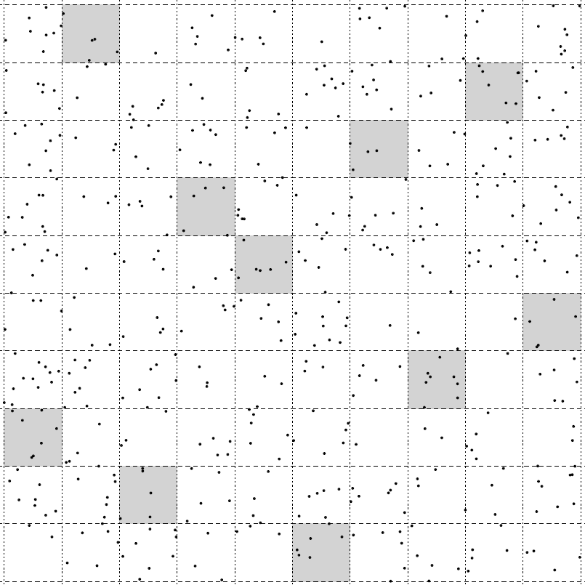
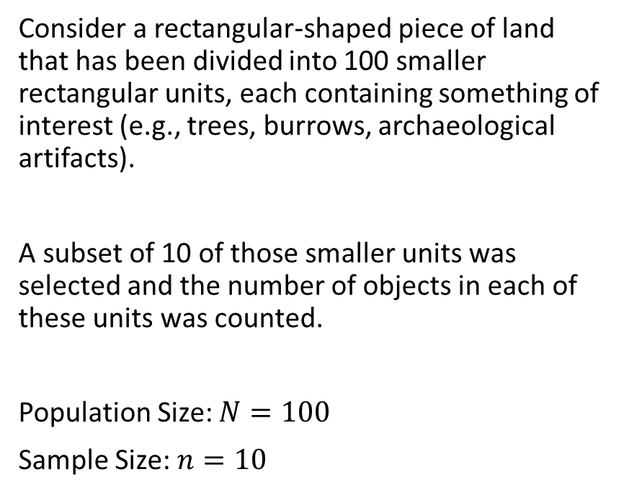
Example 2
Consider a rectangular-shaped piece of land that has been divided into 100 smaller rectangular units, each containing something of interest (e.g., trees, burrows, archaeological artifacts).
A subset of 10 of those smaller units was selected and the number of objects in each of these units was counted.
Population Size: $N=100$
Sample Size: $n=10$

Slide 17
Why is statistics so valuable?
Most of the time, we can’t measure everyone or every unit in the population and therefore must limit our measurements to a sample.
Statistics primarily deals with estimation – the process of inferring an unknown quantity about a population using set of sample data
The tools for estimation allow us to approximate almost everything about populations using only samples.

Slide 18
Where we can go with estimates
With estimates we can
Assess differences among groups and relationships between variables.
Describe populations. Examples of estimates include averages, proportions, measures of variation, and measures of relationship.
Then we can ask and answer questions or formally, test and evaluate hypotheses.

Slide 19




Statistics Vs Parameters
A statistic is a numerical characteristic of a sample that estimates a population parameter.
A parameter is a numerical characteristic of a population that can be estimated by a statistic.
Put another way…
A statistic is a function of the observations of in a sample while a parameter is a function of all observations in the population.
Sample
Statistic
estimate
7.8
$$n$$
Population
Parameter
Value
8.2
$$N$$

Slide 20
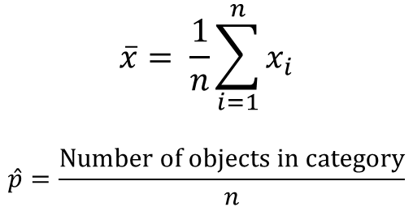
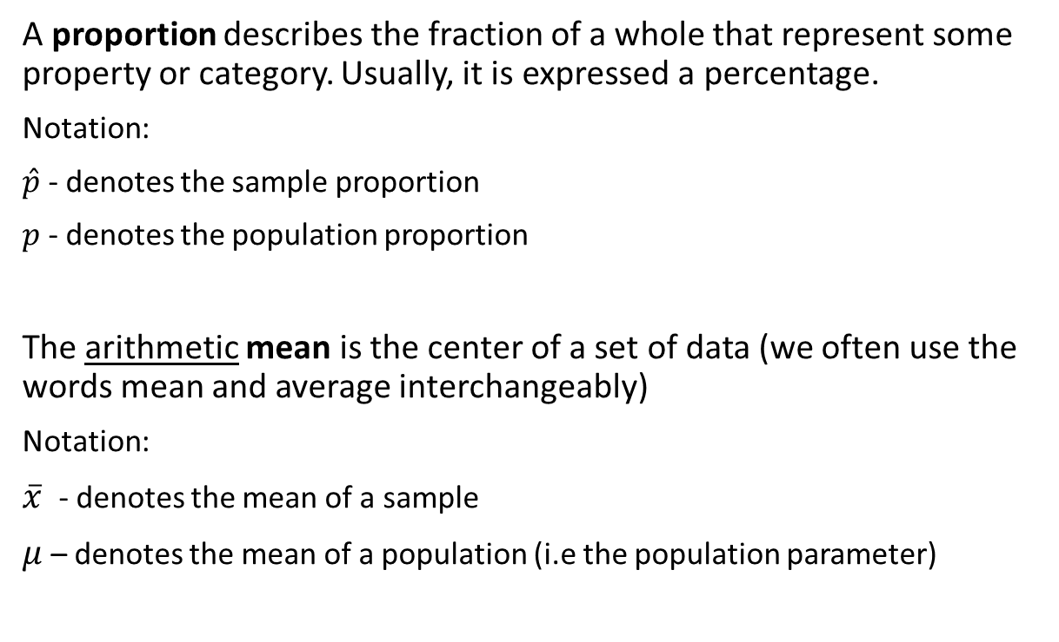
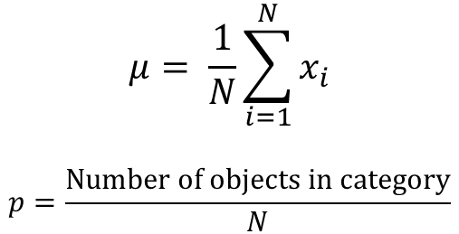
Mean and Proportion
Parameter
$$μ= \frac{1}{N}\sum_{i=1}^{N}{x_{i}}$$
$$p=\frac{Number of objects in category}{N}$$
A proportion describes the fraction of a whole that represent some property or category. Usually, it is expressed a percentage.
Notation:
$\hat{p}$ - denotes the sample proportion
$p$ - denotes the population proportion
The arithmetic mean is the center of a set of data (we often use the words mean and average interchangeably)
Notation:
$\overline{x}$ - denotes the mean of a sample
$μ$ – denotes the mean of a population (i.e the population parameter)
Statistic
$$\overline{x}= \frac{1}{n}\sum_{i=1}^{n}{x_{i}}$$
$$\hat{p}=\frac{Number of objects in category}{n}$$

Slide 21

Example: Gallup Pool
On April 20, 2010, one of the worst environmental disasters took place in the Gulf of Mexico when the Deepwater Horizon offshore oil rig exploded.
In response to the spill, many activists called for an end to offshore drilling for oil.
Almost nine months later, turbulence in the middle east caused the price of oil to surge to an all-time high.
In March 2011, Gallup conducted a survey and found that 60% of Americans favored offshore drilling as means to reduce U.S dependence on foreign oil.
The poll was based on interviews with 1,021 adults aged 18 and older, living in the continental U.S, and selected using random digit dialing.
What is the population under study, and what is the population parameter being estimated? What is the sample statistic ?

Slide 22
Descriptive Vs. Inferential Statistics
Design – The process/method in which we plan to collect data to answer our statistical question
Descriptive Statistics – refers to describing the observations in a sample using statistics or a population using parameters
- collection, organization, summarization and visualization of data
Inferential Statistics (or statistical inference) – refers to using a sample (usually a statistic) to answer a question about a population (such as estimating the value of a parameter)
- estimation, hypothesis testing, determining relationships among variables, prediction

Slide 23
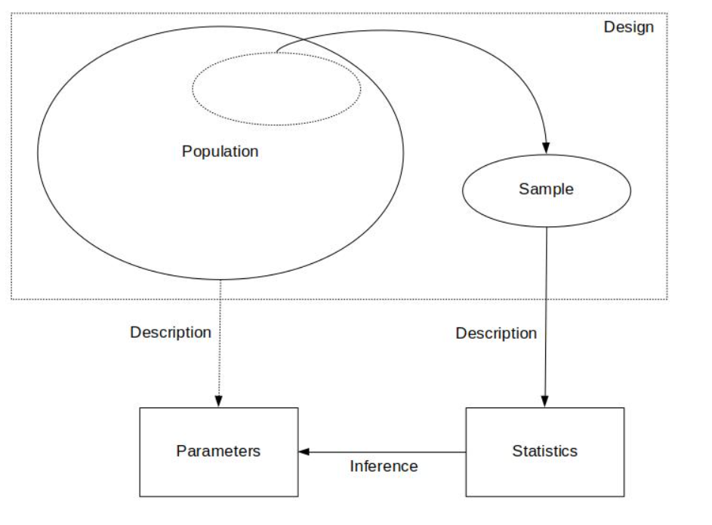
The Big Picture

